Slide 1

Because every child is a miracle. Pediatrician-approved* and loved by moms everywhere.
*DNA Miracles products have been approved by US pediatricians.

Slide 2


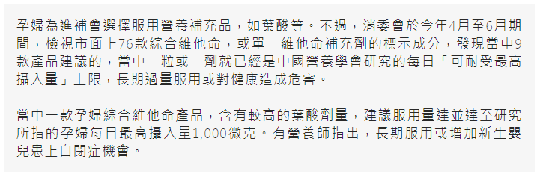
Two Prenatal Supplements found to contain high amount of folic acid
Long term consumption can lead to infant autism
Notes:
https://www.hk01.com/%E7%A4%BE%E6%9C%83%E6%96%B0%E8%81%9E/236658/%E6%B6%88%E5%A7%94%E6%9C%83-2%E6%AC%BE%E5%AD%95%E5%A9%A6%E7%B6%AD%E4%BB%96%E5%91%BD%E8%A3%9C%E5%85%85%E5%8A%91%E8%91%89%E9%85%B8%E9%87%8F%E9%AB%98-%E9%95%B7%E6%9C%9F%E6%9C%8D%E7%94%A8%E6%88%96%E4%BB%A4%E5%AC%B0%E5%85%92%E8%87%AA%E9%96%89

Slide 3
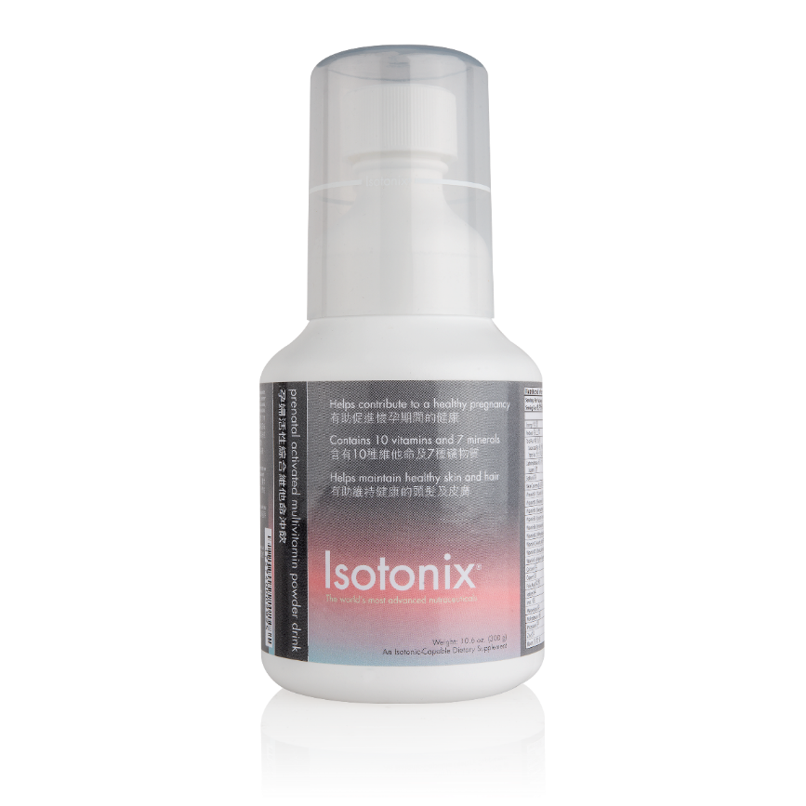
ISOTONIX® PRENATAL ACTIVATED MULTIVITAMIN POWDER DRINK
PRIMARY BENEFITS:
Helps contribute to a healthy pregnancy
Contains 10 vitamins and 7 minerals
Helps maintain healthy skin and hair
Contains activated forms of select B-vitamins
Deficiencies of micronutrients during pregnancy are known causes of low birth weight

Slide 4
According to the American College of Obstetricians and Gynecologists
A pregnant woman needs more:
Calcium – at least 1,000 mg
Folic Acid – 600 µg/day vs. 400 µg/day
Iron – 27 mg/day vs. 18 mg/day
Protein – more is needed during pregnancy

Slide 5
Source: http://perinatology.com/Reference/RDApregnancy.htm
NUTRIENT | CONTENT IN PRODUCT | DIETARY REFERENCE INTAKES
Vitamin B1 | 3 mg | 1.4 mg; UL = Not Determine
Vitamin B2 | 3 mg | 1.4 mg; UL = Not Determine
Vitamin B6 | 4 mg | 1.9 mg; UL = 100 mg
Vitamin B12 | 12 mcg | 2.6 mcg; UL = Not Determine
Vitamin C | 120 mg | 85 mg; UL = 2,000 mg
Vitamin D3 | 1000 IU | 200 IU; UL = 2000 IU
Vitamin E | 30 IU | 22.5 IU; UL = 1,500 IU
Folic Acid | 810 mcg | 600 mg; UL = 1,000 mg
Calcium | 150 mg | 1,000 mg; UL = 2,500 mg
Iron | 20 mg | 27 mg; UL = 45 mg
Calcium – at least 1,000 mg
Folic Acid – 600 µg/day vs. 400 µg/day
Iron – 27 mg/day vs. 18 mg/day
Protein – more is needed during pregnancy
UL = The maximum level of daily nutrient intake that is likely to pose no risk of adverse effects.
ND = Not determinable

Slide 6
DIGESTIVE PROBLEMS DURING PREGNANCY
Such as indigestion, heartburn, constipation and gas:
Hormone levels can affect digestion beyond slowing down bowel movements
Iron supplements
Slower digestive system can lead to gas buildup
Heartburn occurs when stomach acids leak back into esophagus
Eating large meals and eating before lying down can also lead to heartburn
Calcium – at least 1,000 mg
Folic Acid – 600 µg/day vs. 400 µg/day
Iron – 27 mg/day vs. 18 mg/day
Protein – more is needed during pregnancy

Slide 7
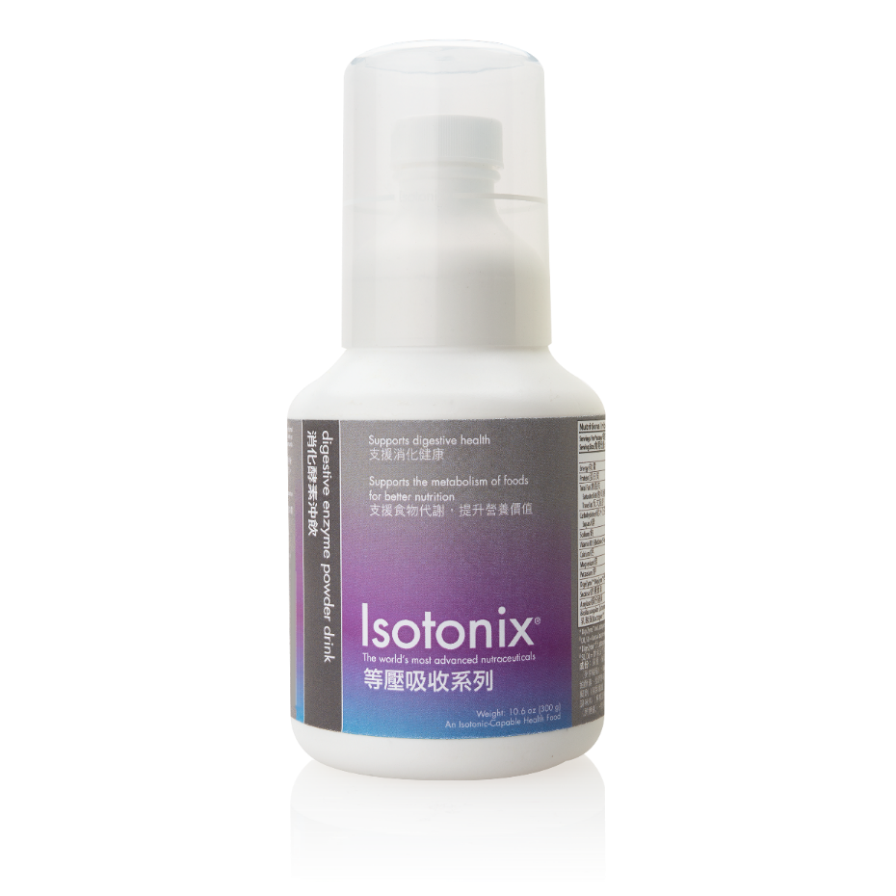
ISOTONIX® DIGESTIVE ENZYME POWDER DRINK
PRIMARY BENEFITS:
Supports digestive health
Supports the metabolism of food for better nutrition
Made from a combination of DigeZyme®* (blend of the enzymes amylase, protease, cellulose, lactase and lipase), Lactospore®* (the probiotic Bacillus coagulans), and sucrase
Calcium – at least 1,000 mg
Folic Acid – 600 µg/day vs. 400 µg/day
Iron – 27 mg/day vs. 18 mg/day
Protein – more is needed during pregnancy
*DigeZyme® and Lactospore® are trademarks of the Sabinsa Corporation.

Slide 8

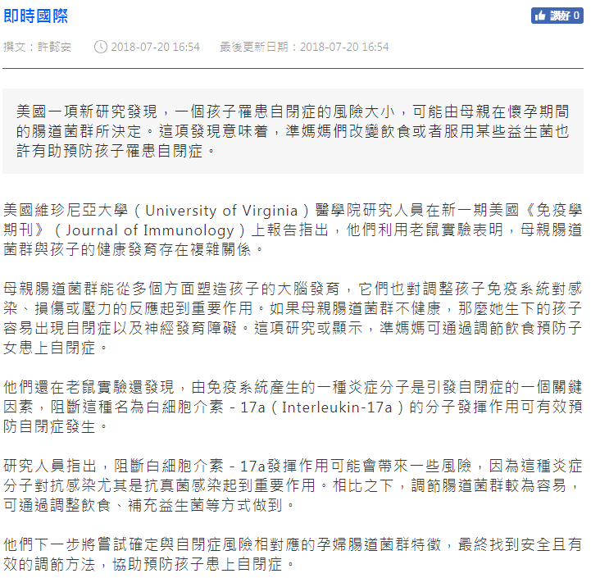
US study: Intestinal flora in pregnant women has a decisive influence on the risk of autism in children
Calcium – at least 1,000 mg
Folic Acid – 600 µg/day vs. 400 µg/day
Iron – 27 mg/day vs. 18 mg/day
Protein – more is needed during pregnancy
Source: https://www.hk01.com/%E5%8D%B3%E6%99%82%E5%9C%8B%E9%9A%9B/213131/%E7%BE%8E%E5%9C%8B%E7%A0%94%E7%A9%B6-%E5%AD%95%E5%A9%A6%E8%85%B8%E9%81%93%E8%8F%8C%E7%BE%A4%E5%B0%8D%E5%85%92%E7%AB%A5%E6%82%A3%E8%87%AA%E9%96%89%E7%97%87%E9%A2%A8%E9%9A%AA%E6%9C%89%E6%B1%BA%E5%AE%9A%E6%80%A7%E5%BD%B1%E9%9F%BF
Notes:
https://www.hk01.com/%E5%8D%B3%E6%99%82%E5%9C%8B%E9%9A%9B/213131/%E7%BE%8E%E5%9C%8B%E7%A0%94%E7%A9%B6-%E5%AD%95%E5%A9%A6%E8%85%B8%E9%81%93%E8%8F%8C%E7%BE%A4%E5%B0%8D%E5%85%92%E7%AB%A5%E6%82%A3%E8%87%AA%E9%96%89%E7%97%87%E9%A2%A8%E9%9A%AA%E6%9C%89%E6%B1%BA%E5%AE%9A%E6%80%A7%E5%BD%B1%E9%9F%BF

Slide 9


COMPREHENSIVE PRODUCT LINE

Slide 10
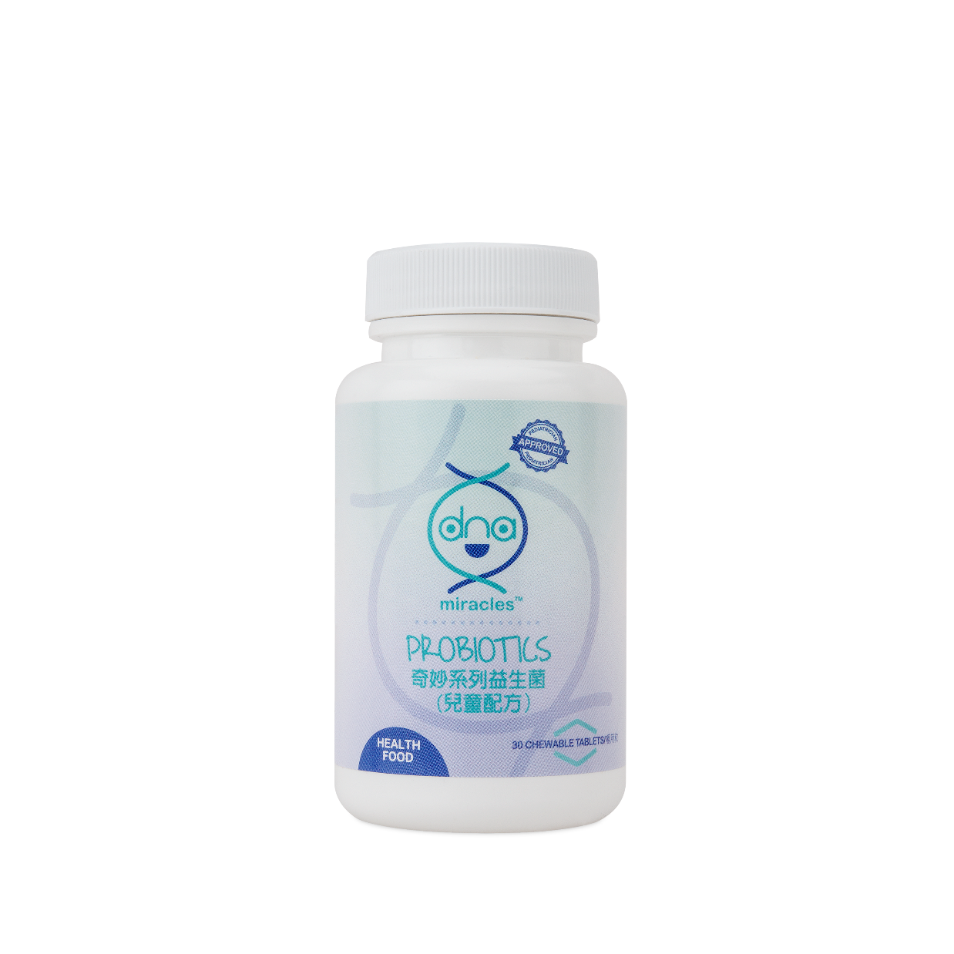
DNA MIRACLES® PROBIOTICS

Slide 11
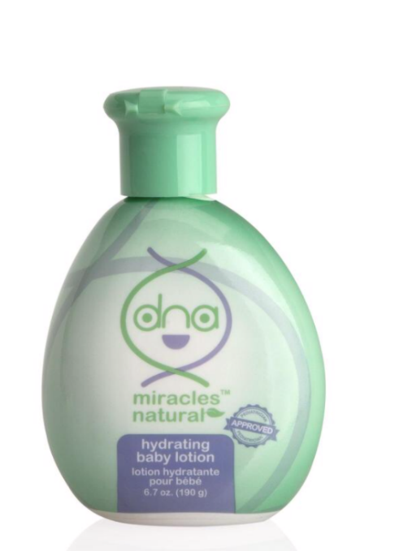
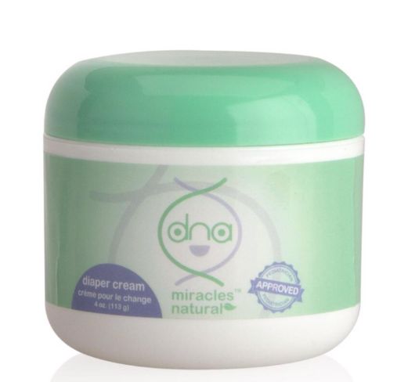
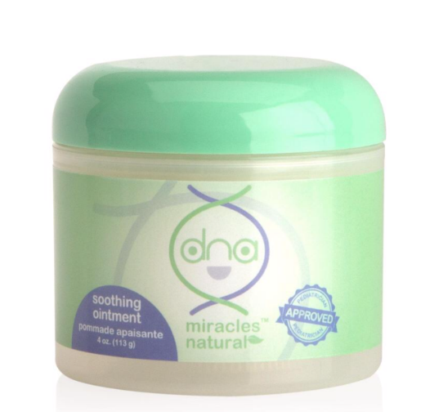
DNA MIRACLES® NATURAL DIAPER CREAM, SOOTHING OINTMENT & LOTION

Slide 12
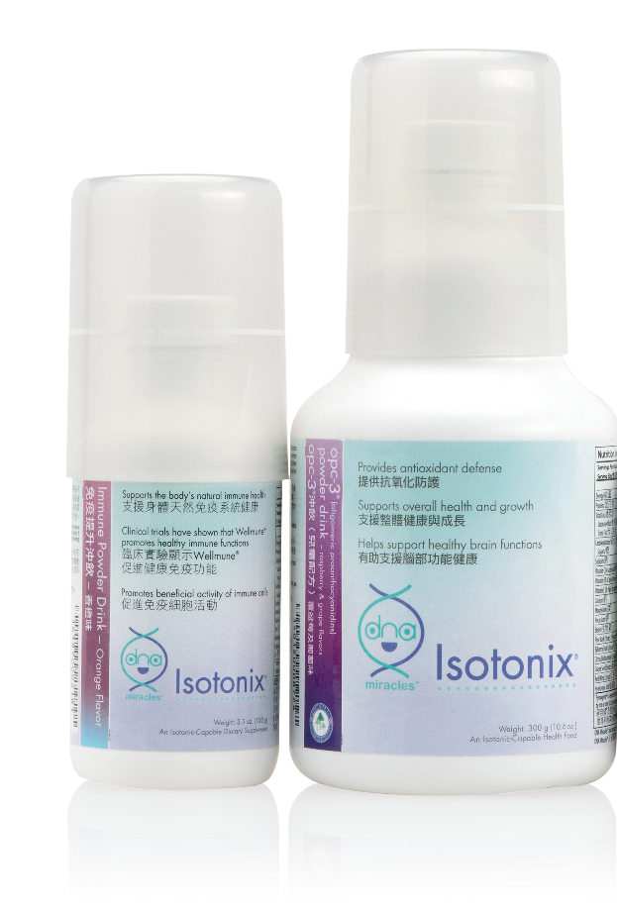
DNA MIRACLES ISOTONIX OPC-3 POWDER DRINK & IMMUNE POWDER DRINK

Slide 13
Because every child is a miracle. Pediatrician-approved* and loved by moms everywhere.
*DNA Miracles products have been approved by US pediatricians.

